Slide 1


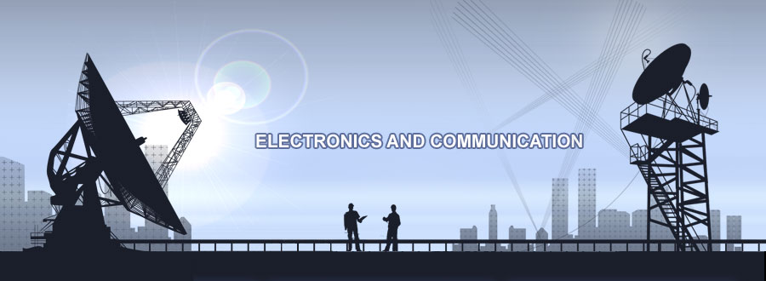
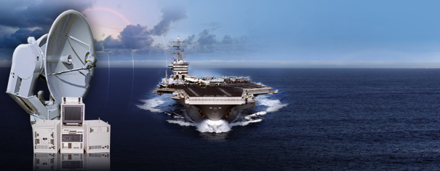
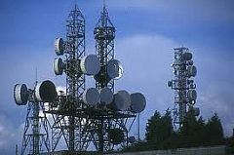
ELNG 307 – ANALOG AND DIGITAL COMMUNICATIONS

Slide 2
University of Energy and Natural Resources, Sunyani
Dept. of Computer & Electrical Eng.
ELNG 307 – ANALOG AND DIGITAL COMMUNICATIONS
Tweneboah-Koduah S.

Slide 3
Chapter 4 – Linear Modulation Fundamental
There are too many people praying for mountains of difficulty to be removed, when what they really need is the courage to climb them!
– Unknown

Slide 4
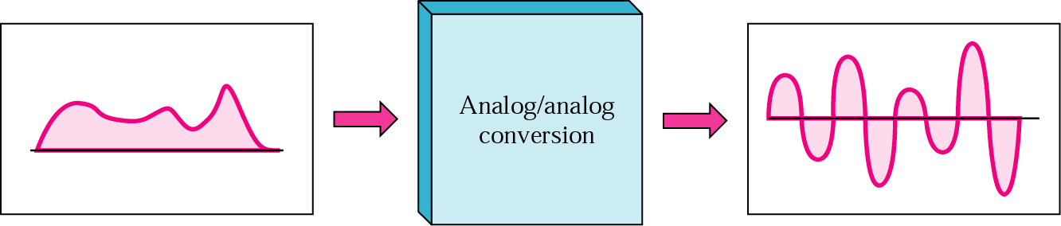
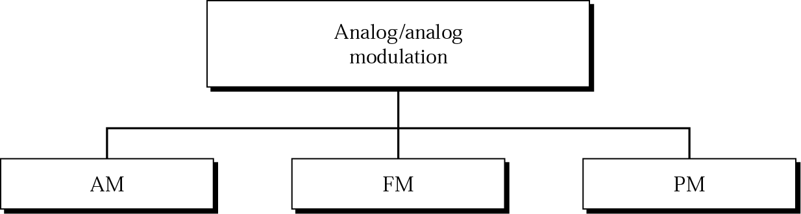
Analogue Modulation Methods

Slide 5
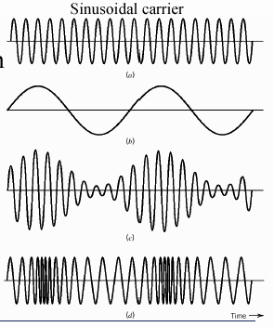
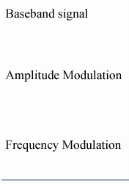

Slide 6
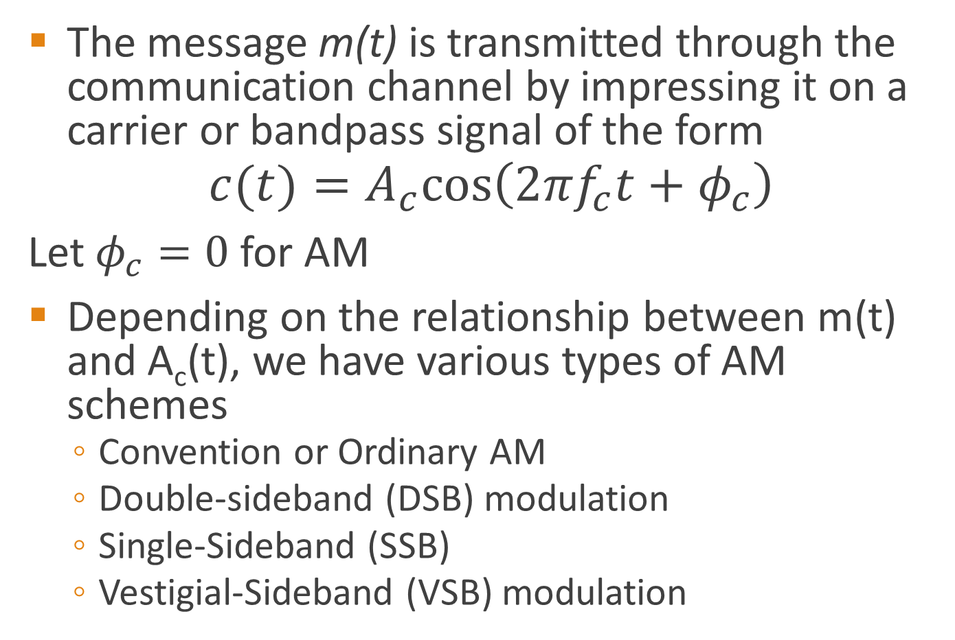
Amplitude modulation (AM)
The message m(t) is transmitted through the communication channel by impressing it on a carrier or bandpass signal of the form
$$c(t)=A_{c}cos\left(2πf_{c}t+φ_{c}\right)$$
Let $φ_{c}=0$ for AM
Depending on the relationship between m(t) and A_{c}(t), we have various types of AM schemes
  Convention or Ordinary AM
  Double-sideband (DSB) modulation
  Single-Sideband (SSB)
  Vestigial-Sideband (VSB) modulation

Slide 7
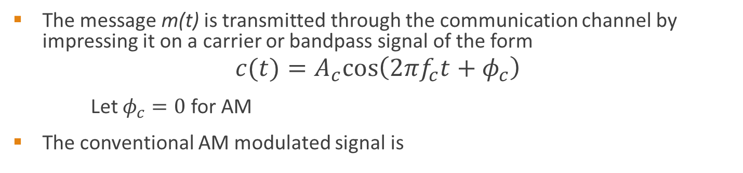

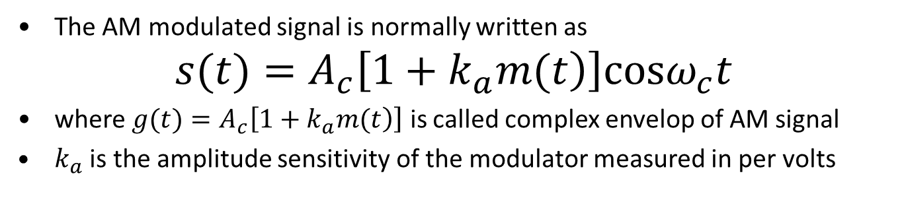
Amplitude modulation (AM)
The message m(t) is transmitted through the communication channel by impressing it on a carrier or bandpass signal of the form
$$c(t)=A_{c}cos\left(2πf_{c}t+φ_{c}\right)$$
Let $φ_{c}=0$ for AM
The conventional AM modulated signal is
The AM modulated signal is normally written as
$$s(t)=A_{c}\left[\left.1+k_{a}m(t\right)\right]cosω_{c}t$$
where $g(t)=A_{c}\left[\left.1+k_{a}m(t\right)\right]$ is called complex envelop of AM signal
$k_{a}$ is the amplitude sensitivity of the modulator measured in per volts
$k_{a}=\frac{1}{A_{c}}$, V⁻¹

Slide 8
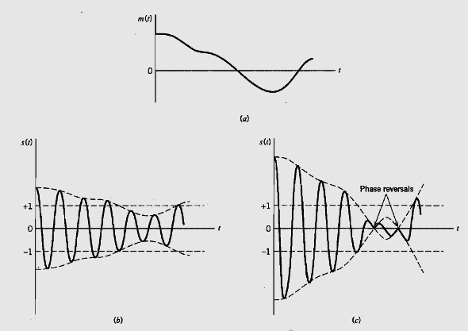
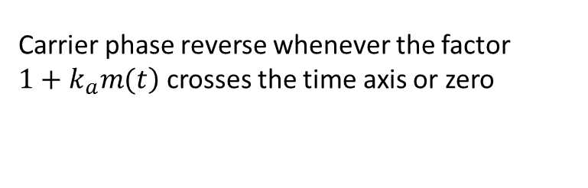
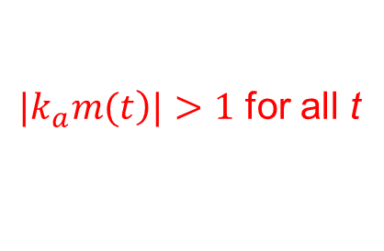
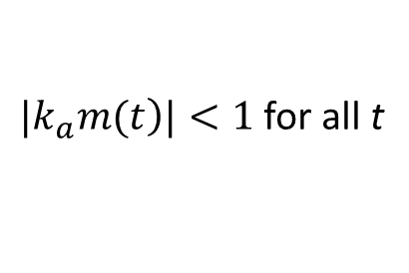
Amplitude modulation (AM)
Effects of k_{a} – the modulation sensitivity
$|\left.k_{a}m(t\right)|<1$ for all t
$|\left.k_{a}m(t\right)|>1$ for all t
For all t, we overmodulation
Carrier phase reverse whenever the factor $\left.1+k_{a}m(t\right)$ crosses the time axis or zero
Notes:
$|\left.k_{a}m(t\right)|>1$ for all t, the carrier becomes over modulated resulting in carrier phase reversal whenever the factor $\left.1+k_{a}m(t\right)$ crosses the time axis or zero

Slide 9
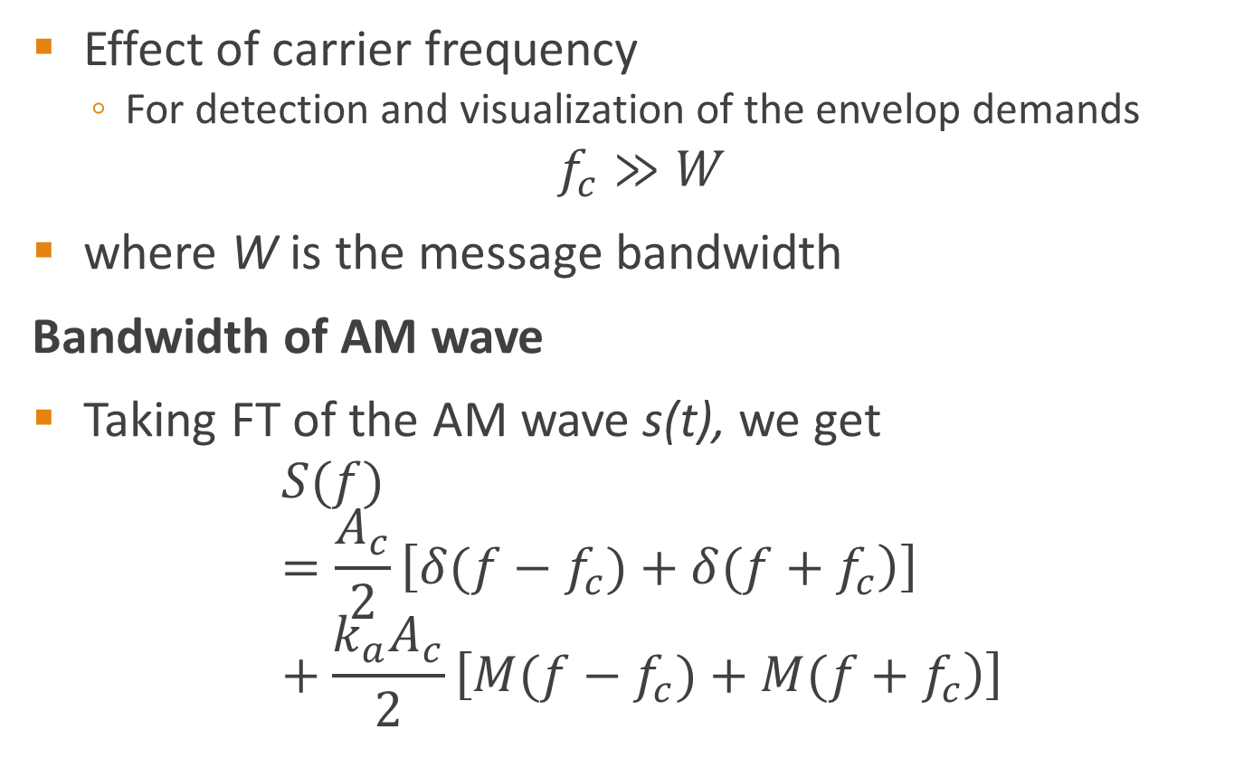
Amplitude modulation (AM)
Effect of carrier frequency
  For detection and visualization of the envelop demands
$$f_{c}≫W$$
where W is the message bandwidth
Bandwidth of AM wave
Taking FT of the AM wave s(t), we get
$$S(f)=\frac{A_{c}}{2}\left[\left.δ(f−f_{c})+δ(f+f_{c}\right)\right]+\frac{k_{a}A_{c}}{2}\left[\left.M(f−f_{c})+M(f+f_{c}\right)\right]$$

Slide 10
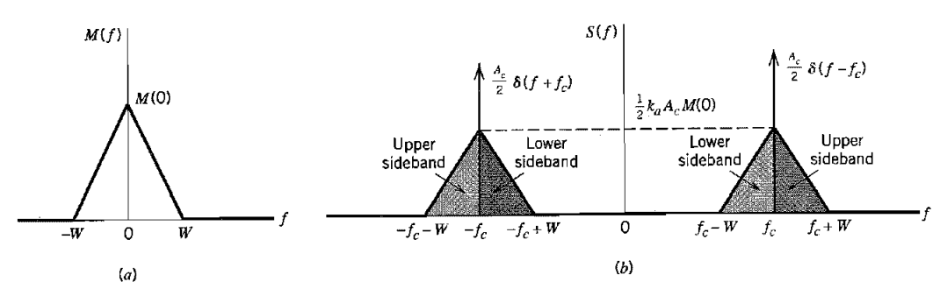
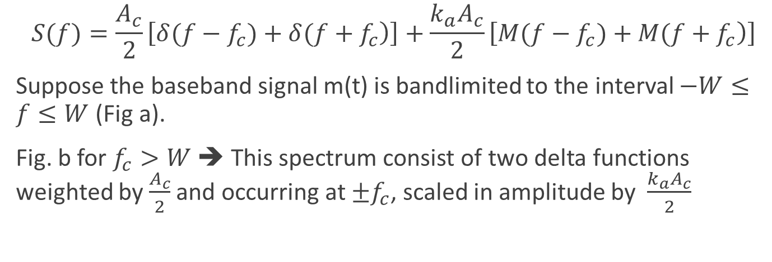
Amplitude modulation (AM)
$$S(f)=\frac{A_{c}}{2}\left[\left.δ(f−f_{c})+δ(f+f_{c}\right)\right]+\frac{k_{a}A_{c}}{2}\left[\left.M(f−f_{c})+M(f+f_{c}\right)\right]$$
Suppose the baseband signal m(t) is bandlimited to the interval $−W≤f≤W$ (Fig a).
Fig. b for $f_{c}>W$ ➔ This spectrum consist of two delta functions weighted by $\frac{A_{c}}{2}$ and occurring at $±f_{c}$, scaled in amplitude by $\frac{k_{a}A_{c}}{2}$

Slide 11
Frequency Spectrum of an AM signal
The frequency spectrum of AM waveform contains three parts:
  1. A component at the carrier frequency f_{c}
  2. An upper side band (USB), whose highest frequency component is at f_{c} + f_{m}
  3. A lower side band (LSB), whose highest frequency component is at f_{c} - f_{m}
The bandwidth of the modulated waveform is twice the information signal bandwidth.

Slide 12
Example
A 1.4 MHz carrier is modulated by a music signal that has frequency components from 20 Hz to 15 kHz. Determine the range of frequencies generated for the upper and lower sidebands.
Solution
The upper side band is equal to the sum of carrier and intelligence frequencies. Therefore, the upper side band (usb) will include the frequencies from

Slide 13
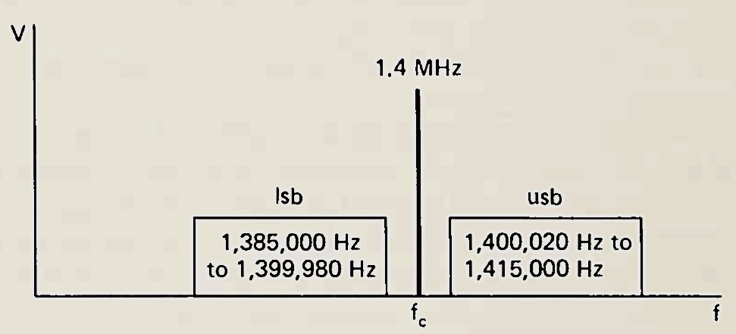
Example
A 1.4 MHz carrier is modulated by a music signal that has frequency components from 20 Hz to 15 kHz. Determine the range of frequencies generated for the upper and lower sidebands.
Solution
The upper side band is equal to the sum of carrier and intelligence frequencies. Therefore, the upper side band (usb) will include the frequencies from

Slide 14
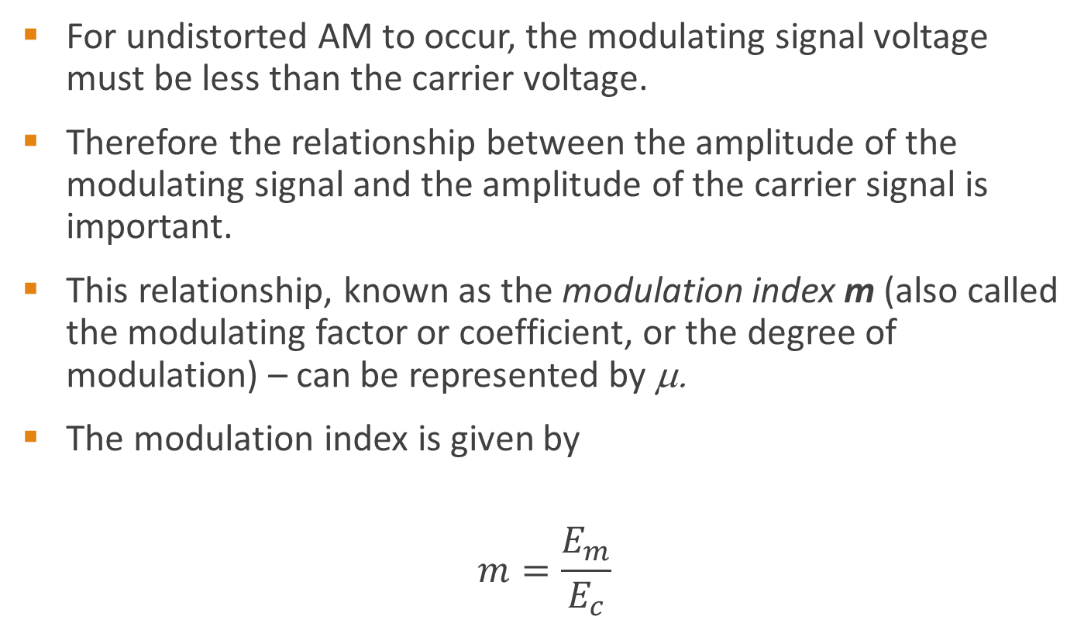
AM modulation index
For undistorted AM to occur, the modulating signal voltage must be less than the carrier voltage.
Therefore the relationship between the amplitude of the modulating signal and the amplitude of the carrier signal is important.
This relationship, known as the modulation index m (also called the modulating factor or coefficient, or the degree of modulation) – can be represented by μ.
The modulation index is given by
$$m=\frac{E_{m}}{E_{c}}$$
Notes:
The ratio of change in amplitude of modulating signal to the amplitude of carrier wave is know as modulation index or factor

Slide 15
AM modulation index
What is the significance of modulation index ?
m is merely defined as a parameter, which determines the amount of modulation.
What is the degree of modulation required to establish a desirable AM communication link?
Answer is to maintain m<1.0 (m < 100%).
This is important for successful retrieval of the original transmitted information at the receiver end.

Slide 16
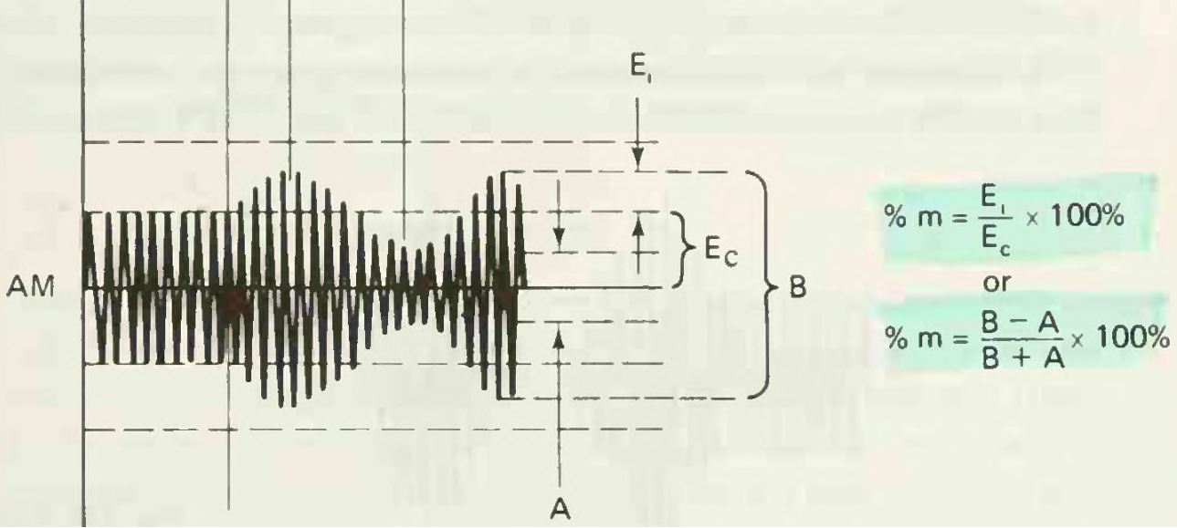
AM modulation index using envelope
Let Ei = Em, B = Emax, A = Emin
Emax is the maximum voltage peak-to-peak AM signal
Emin is the minimum voltage peak-to-peak AM signal
m is the modulation index

Slide 17
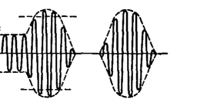
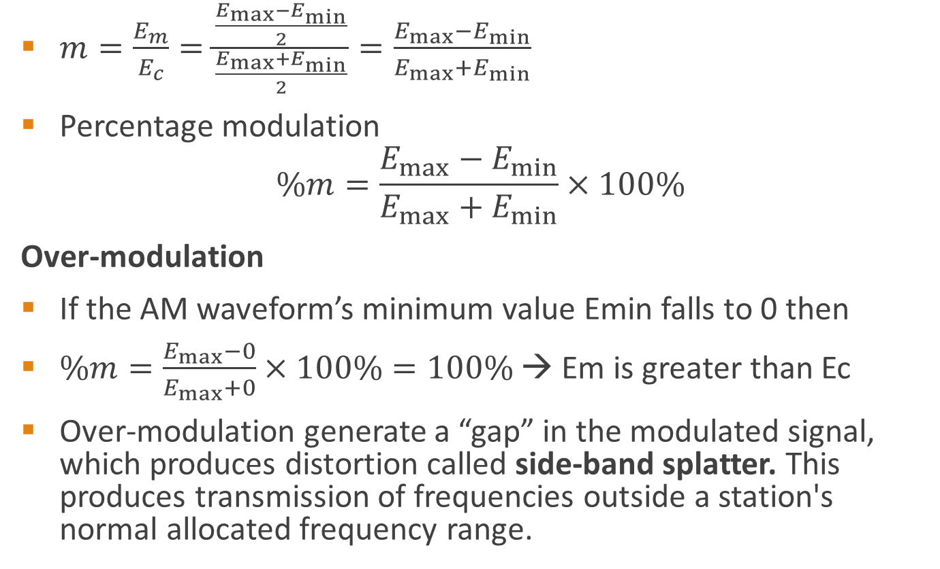
AM modulation index
$m=\frac{E_{m}}{E_{c}}=\frac{\frac{E_{max}−E_{min}}{2}}{\frac{E_{max}+E_{min}}{2}}=\frac{E_{max}−E_{min}}{E_{max}+E_{min}}$
Percentage modulation
$$\%m=\frac{E_{max}−E_{min}}{E_{max}+E_{min}}×100\%$$
Over-modulation
If the AM waveform’s minimum value Emin falls to 0 then
$\%m=\frac{E_{max}−0}{E_{max}+0}×100\%=100\%$ → Em is greater than Ec
Over-modulation generate a “gap” in the modulated signal, which produces distortion called side-band splatter. This produces transmission of frequencies outside a station's normal allocated frequency range.

Slide 18
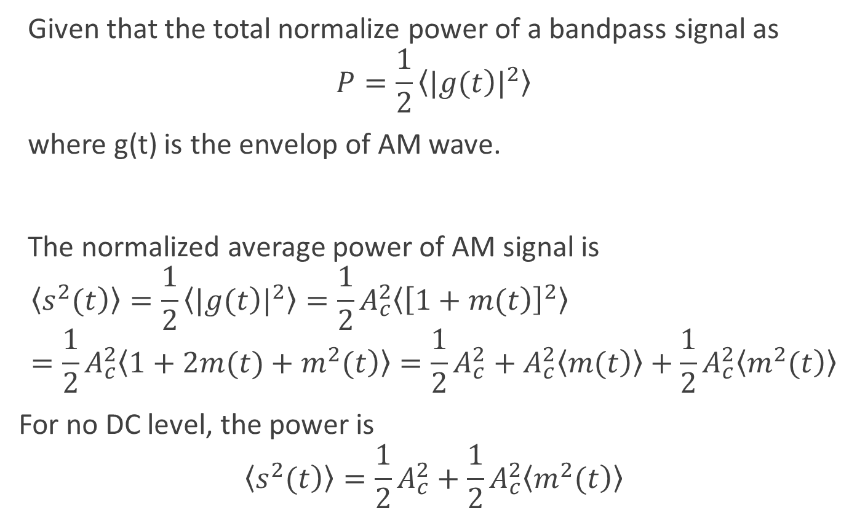
AM power and efficiency
Given that the total normalize power of a bandpass signal as
$$P=\frac{1}{2}〈{|\left.g(t\right)|}^{2}〉$$
where g(t) is the envelop of AM wave.
The normalized average power of AM signal is
$$〈\left.s^{2}(t\right)〉=\frac{1}{2}〈{|\left.g(t\right)|}^{2}〉=\frac{1}{2}A_{c}^{2}〈{\left[\left.1+m(t\right)\right]}^{2}〉=\frac{1}{2}A_{c}^{2}〈\left.1+2m(t)+m^{2}(t\right)〉=\frac{1}{2}A_{c}^{2}+A_{c}^{2}〈\left.m(t\right)〉+\frac{1}{2}A_{c}^{2}〈\left.m^{2}(t\right)〉$$
For no DC level, the power is
$$〈\left.s^{2}(t\right)〉=\frac{1}{2}A_{c}^{2}+\frac{1}{2}A_{c}^{2}〈\left.m^{2}(t\right)〉$$
Carrier power, Pc
Sideband power, Ps

Slide 19
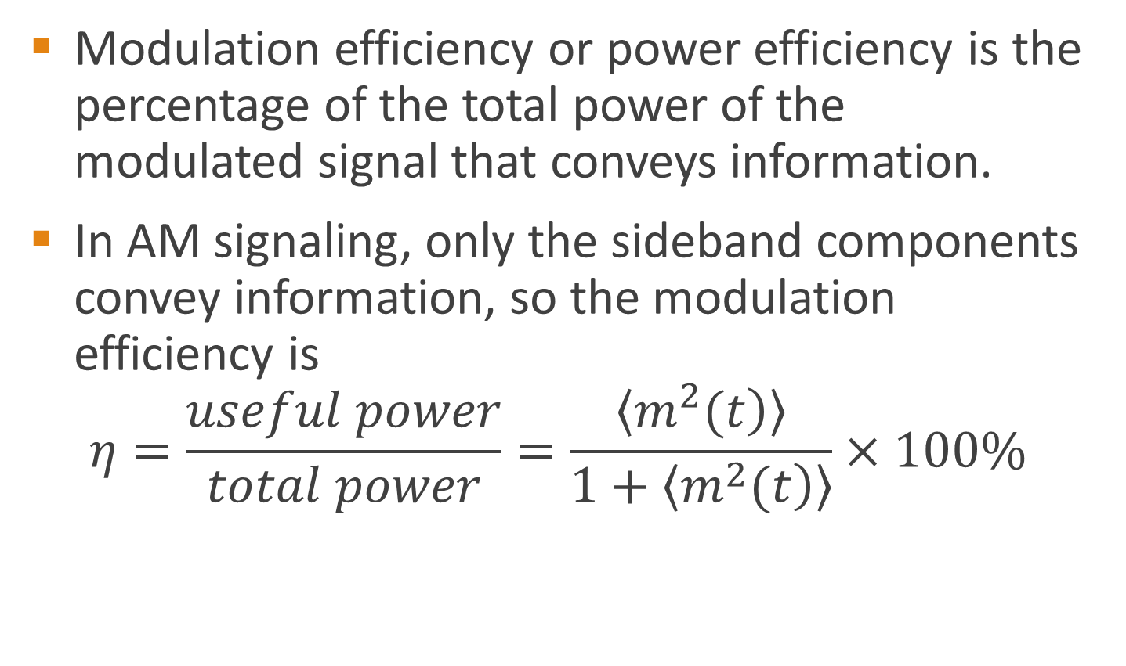
AM power and efficiency
Modulation efficiency or power efficiency is the percentage of the total power of the
modulated signal that conveys information.
In AM signaling, only the sideband components convey information, so the modulation efficiency is
$$η=\frac{useful power}{total power}=\frac{〈\left.m^{2}(t\right)〉}{1+〈\left.m^{2}(t\right)〉}×100\%$$

Slide 20
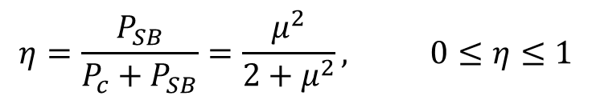
AM power and efficiency
Modulation efficiency or power efficiency is the percentage of the total power of the
modulated signal that conveys information.
$$η=\frac{P_{SB}}{P_{c}+P_{SB}}=\frac{μ^{2}}{2+μ^{2}}, 0≤η≤1$$
It is seen that η increases monotonically with μ, and η_{max} occurs at μ = 1, for which η_{max} = 33 %.
Thus, for tone modulation, under best conditions (μ = 1), only one-third of the transmitted power is used for carrying message.

Slide 21
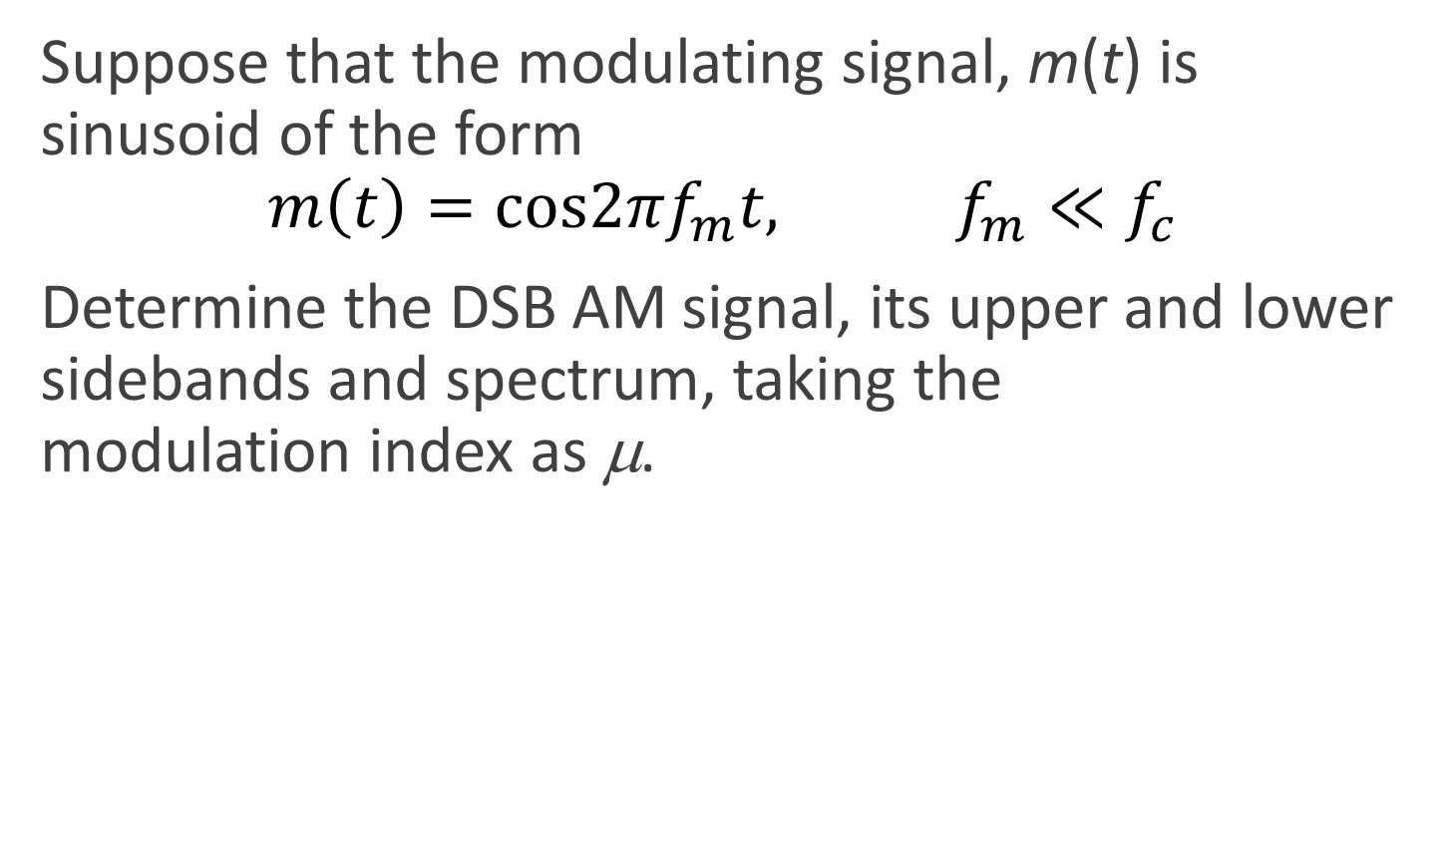
Example 4.2 pg 85
Suppose that the modulating signal, m(t) is sinusoid of the form
$m\left(t\right)=cos2πf_{m}t, f_{m}≪f_{c}$
Determine the DSB AM signal, its upper and lower sidebands and spectrum, taking the
modulation index as μ.

Slide 22
Example 4.3 pg 86
Suppose that on an AM signal, the A_{max(p-p)} value read from the graticule on the oscilloscope
screen is 5.9 divisions and A_{min(p-p)} is 1.2 divisions.
i. What is the modulation index?
ii. Calculate A_{c}, A_{m}, and m if the vertical scale is 2 V per division. (Hint: Sketch the signal)

Slide 23
Example 4.4 pg 87
Derive an expression for multitone amplitude modulation, total transmitted power and total
modulation index

Slide 24
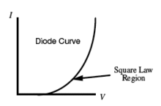
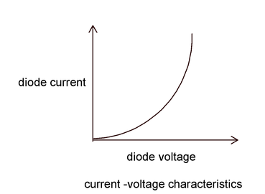
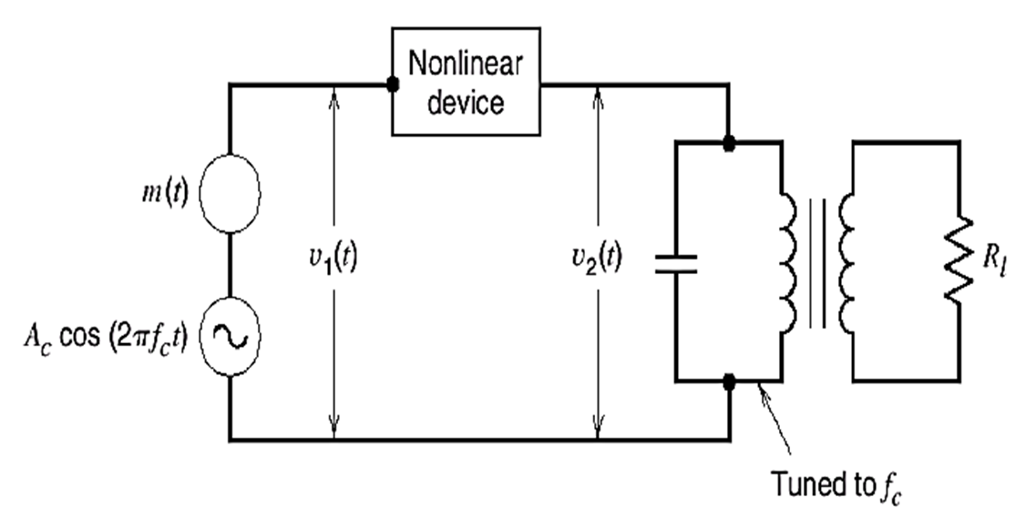
Generation of ordinary AM wave
Power-law or Square-law modulator
The Square-law modulator consist of Summer – It adds the carrier and the modulating signal
Non-linear device – a device with non-linear input-output relation and Band-pass filter (BPF)
– this extract the deserved signal from the modulator product

Slide 25
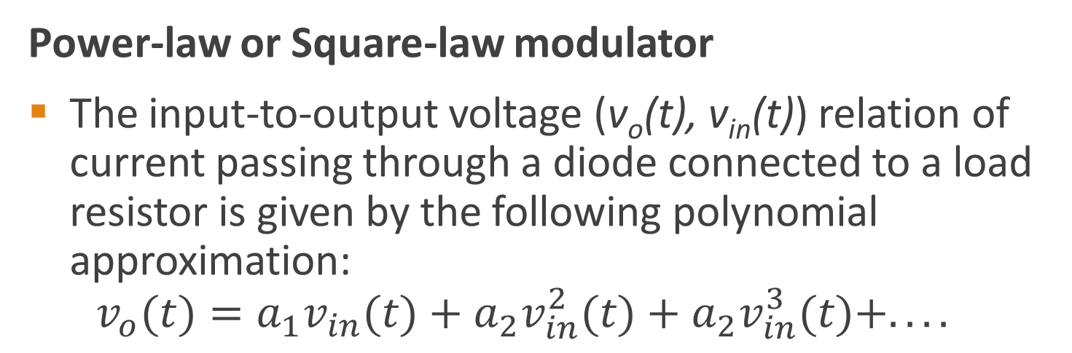
Generation of ordinary AM wave
Power-law or Square-law modulator
The input-to-output voltage (v_{o}(t), v_{in}(t)) relation of current passing through a diode connected to a load resistor is given by the following polynomial approximation:
$v_{o}(t)=a_{1}v_{in}(t)+a_{2}v_{in}^{2}(t)+a_{2}v_{in}^{3}(t)+....$

Slide 26
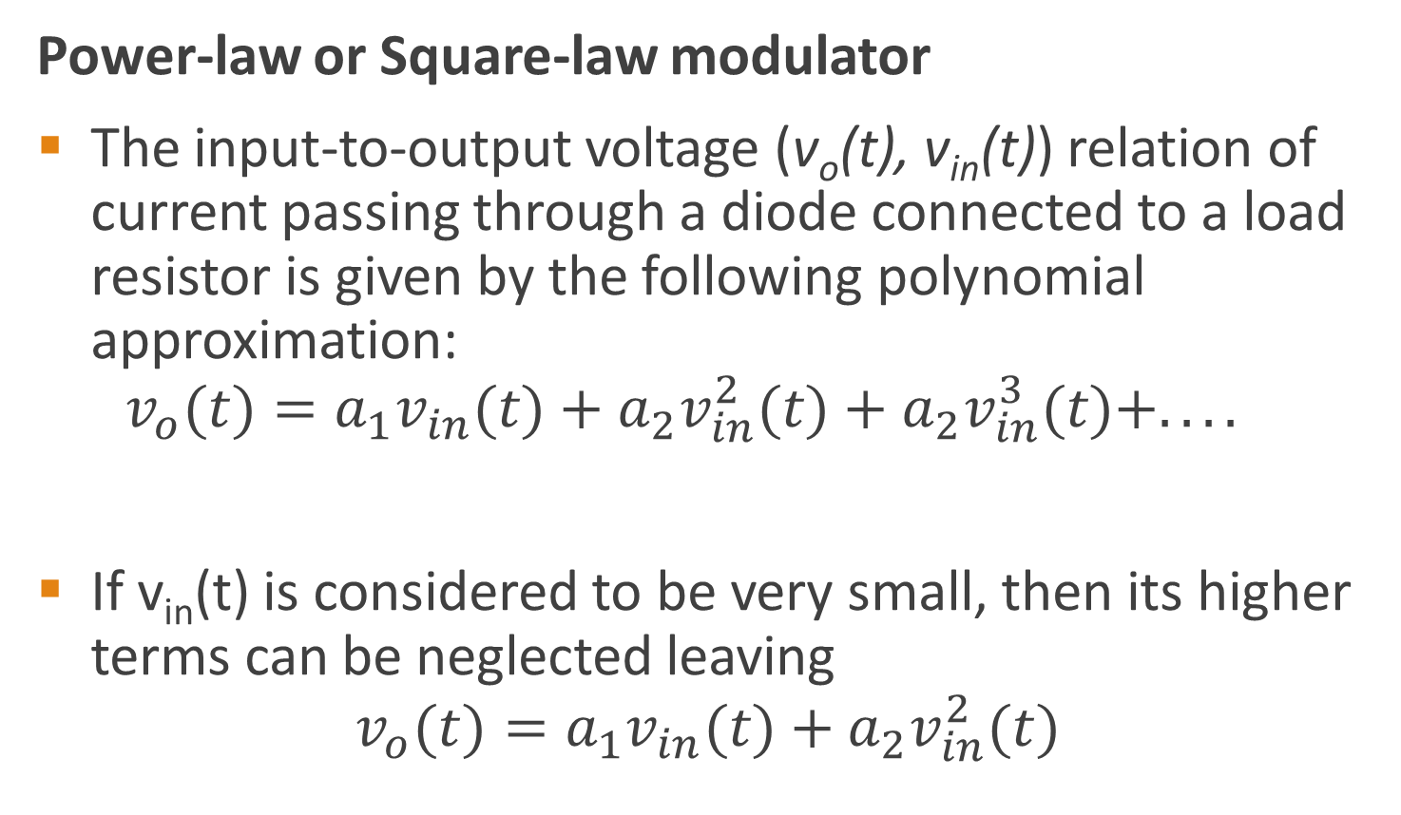
Generation of ordinary AM wave
Power-law or Square-law modulator
The input-to-output voltage (v_{o}(t), v_{in}(t)) relation of current passing through a diode connected to a load resistor is given by the following polynomial approximation:
$v_{o}(t)=a_{1}v_{in}(t)+a_{2}v_{in}^{2}(t)+a_{2}v_{in}^{3}(t)+....$
If v_{in}(t) is considered to be very small, then its higher terms can be neglected leaving
$$v_{o}(t)=a_{1}v_{in}(t)+a_{2}v_{in}^{2}(t)$$

Slide 27

Generation of ordinary AM wave
Power-law or Square-law modulator
If v_{in}(t) is considered to be very small, then its higher terms can be neglected leaving
$$v_{o}(t)=a_{1}v_{in}(t)+a_{2}v_{in}^{2}(t)$$
Taking $v_{in}(t)=m(t)+A_{c}cosω_{c}t$, the output is given as
For the square-law modulator to work, the carrier frequency should be at least three times the maximum frequency of the baseband signal.
Notes:
The desired AM wave is obtained by passing vo(t) through a BPF centred at wc

Slide 28
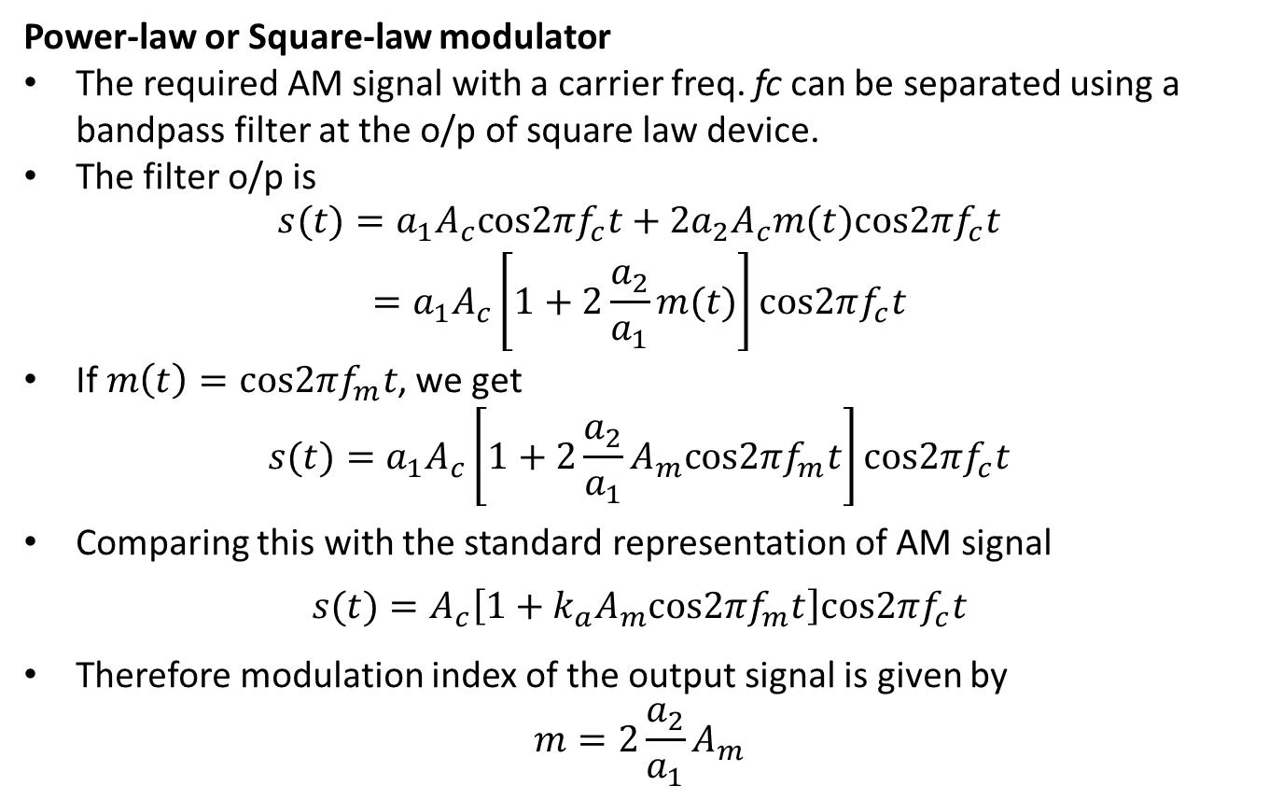
Generation of ordinary AM wave
Power-law or Square-law modulator
The required AM signal with a carrier freq. fc can be separated using a bandpass filter at the o/p of square law device.
The filter o/p is
$$\begin{matrix}s(t)=a_{1}A_{c}cos2πf_{c}t+2a_{2}A_{c}m(t)cos2πf_{c}t \\ =a_{1}A_{c}\left[1+2\frac{a_{2}}{a_{1}}m(t)\right]cos2πf_{c}t\end{matrix}$$
If $m\left(t\right)=cos2πf_{m}t$, we get
$$s(t)=a_{1}A_{c}\left[1+2\frac{a_{2}}{a_{1}}A_{m}cos2πf_{m}t\right]cos2πf_{c}t$$
Comparing this with the standard representation of AM signal
$$s(t)=A_{c}\left[1+k_{a}A_{m}cos2πf_{m}t\right]cos2πf_{c}t$$
Therefore modulation index of the output signal is given by
$$m=2\frac{a_{2}}{a_{1}}A_{m}$$

Slide 29
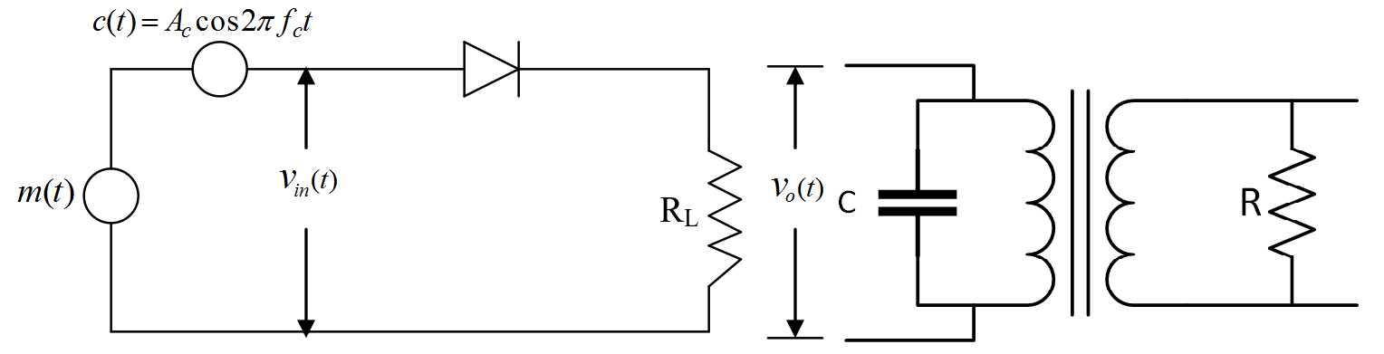
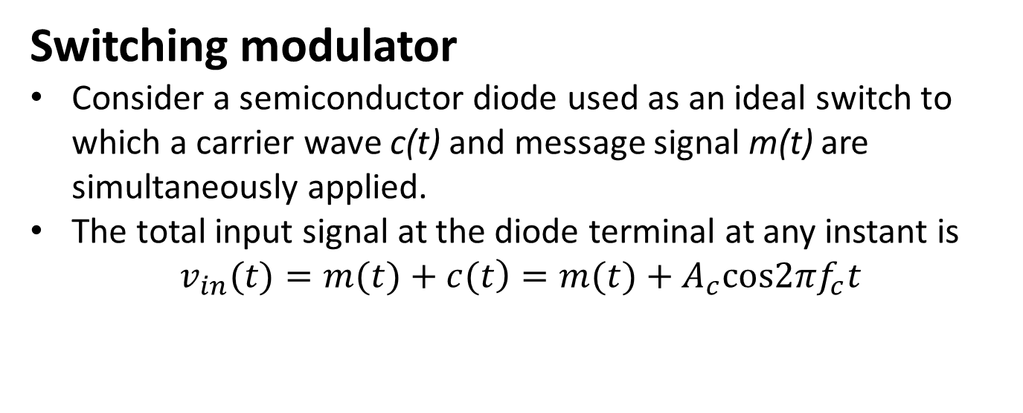
Generation of ordinary AM wave
Switching modulator
Consider a semiconductor diode used as an ideal switch to which a carrier wave c(t) and message signal m(t) are simultaneously applied.
The total input signal at the diode terminal at any instant is
$$\left.v_{in}(t)=m(t)+c(t\right)=m(t)+A_{c}cos2πf_{c}t$$

Slide 30
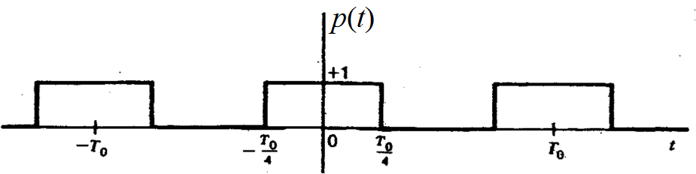
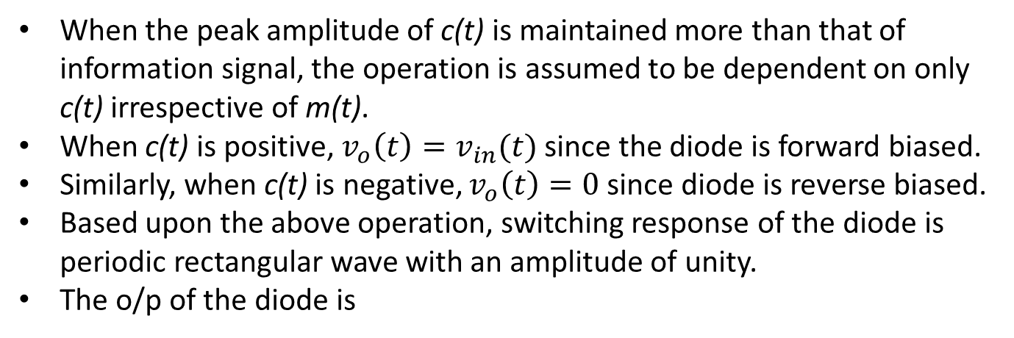
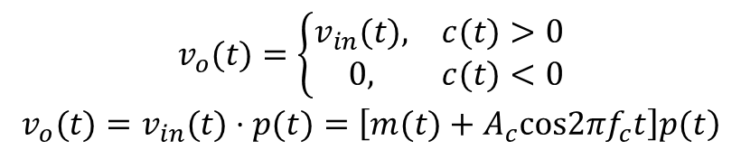
Switching modulator
When the peak amplitude of c(t) is maintained more than that of information signal, the operation is assumed to be dependent on only c(t) irrespective of m(t).
When c(t) is positive, $v_{o}\left(t\right)=v_{in}(t)$ since the diode is forward biased.
Similarly, when c(t) is negative, $v_{o}\left(t\right)=0$ since diode is reverse biased.
Based upon the above operation, switching response of the diode is periodic rectangular wave with an amplitude of unity.
The o/p of the diode is
$$\begin{matrix}v_{o}(t)=\left\{\begin{matrix}v_{in}(t), & c(t)>0 \\ 0, & c(t)<0\end{matrix}\right. \\ \left.v_{o}(t)=v_{in}(t)⋅p(t)=\left[m(t)+A_{c}cos2πf_{c}t\right]p(t\right)\end{matrix}$$

Slide 31
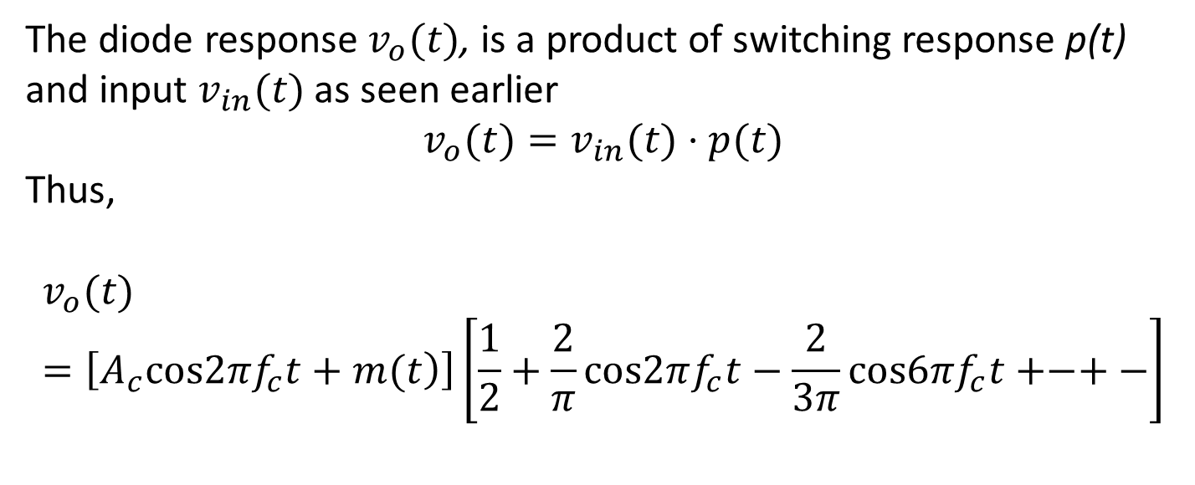
Switching modulator
The diode response $v_{o}(t)$, is a product of switching response p(t) and input $v_{in}(t)$ as seen earlier
$$v_{o}(t)=v_{in}(t)⋅p(t)$$
Thus,
$$v_{o}(t)=\left[\left.A_{c}cos2πf_{c}t+m(t\right)\right]\left[\frac{1}{2}+\frac{2}{π}cos2πf_{c}t−\frac{2}{3π}cos6πf_{c}t+−+−\right]$$
The required AM signal centered at fc can be separated using band pass filter.
The filter output is given by the ff equation

Slide 32
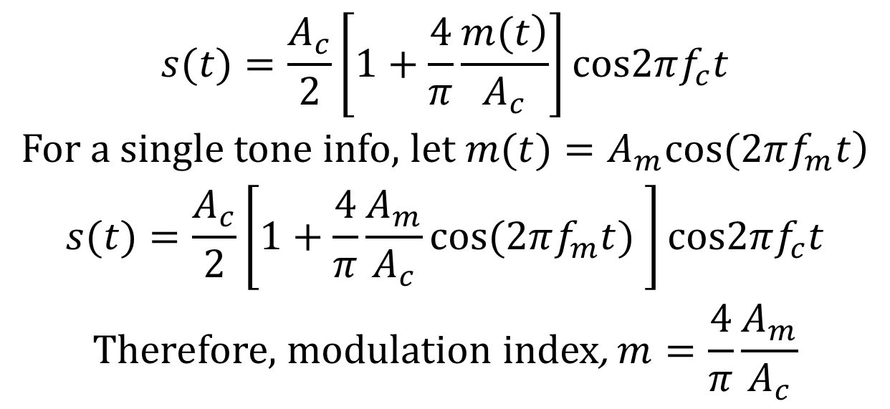
Switching modulator
The required AM signal centered at fc can be separated using band pass filter.
The filter output is given by
$$\begin{matrix}s(t)=\frac{A_{c}}{2}\left[1+\frac{4}{π}\frac{\left.m(t\right)}{A_{c}}\right]cos2πf_{c}t \\ \left.\text{For} \text{a} \text{single} \text{tone} \text{info}\text{, }\text{let} m(t)=A_{m}cos(2πf_{m}t\right) \\ s(t)=\frac{A_{c}}{2}\left[1+\frac{4}{π}\frac{A_{m}}{A_{c}}cos(2πf_{m}t) \right]cos2πf_{c}t \\ \text{Therefore}\text{, }\text{modulation} \text{index}\text{, }m=\frac{4}{π}\frac{A_{m}}{A_{c}}\end{matrix}$$
Notes:
The lower cutoff-frequency for the band pass filter should be between w and fc – w and the upper cut-off frequency between fc + w and 2fc.
$$v_{2}=\left[\left.A_{c}cos2πf_{c}t+m(t\right)\right]\left[\frac{1}{2}+\frac{2}{π}cos2πf_{c}t−\frac{2}{3π}cos6πf_{c}t+−+−\right]$$

Slide 33
Demodulation of conventional AM signal
Demodulation is the process of recovering the information signal (baseband) from the incoming modulated signal at the receiver.
There are two methods:
Square law demodulator and
Envelop detector
Notes:
The desired AM wave is obtained by passing vo(t) through a BPF centred at wc

Slide 34
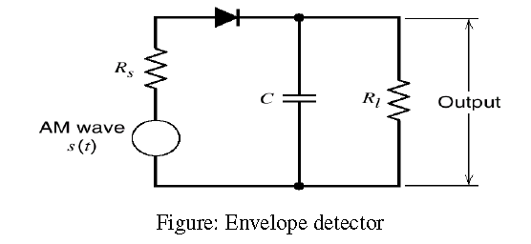
Demodulation of conventional AM signal
Envelop detector
Envelope detector is a simple and highly effective device use to demodulate AM wave.
It consist of diode and a resistor-capacitor (RC) filter
Notes:
The desired AM wave is obtained by passing vo(t) through a BPF centred at wc

Slide 35
Demodulation of conventional AM signal
Envelop detector
During the positive half cycles of the input signals, the diode D is forward biased and the capacitor C charges up quickly to the peak of the input signal.
When the input signal falls below the peak value, the diode becomes reverse biased and the capacitor C discharges through the load resistor R_{L}.
The discharge process continues until the next positive half cycle.
When the input signal becomes greater than the voltage across the capacitor, the diode conducts again and the process is repeated.
As a result only positive half cycle of AM wave appears across R_{L}

Slide 36
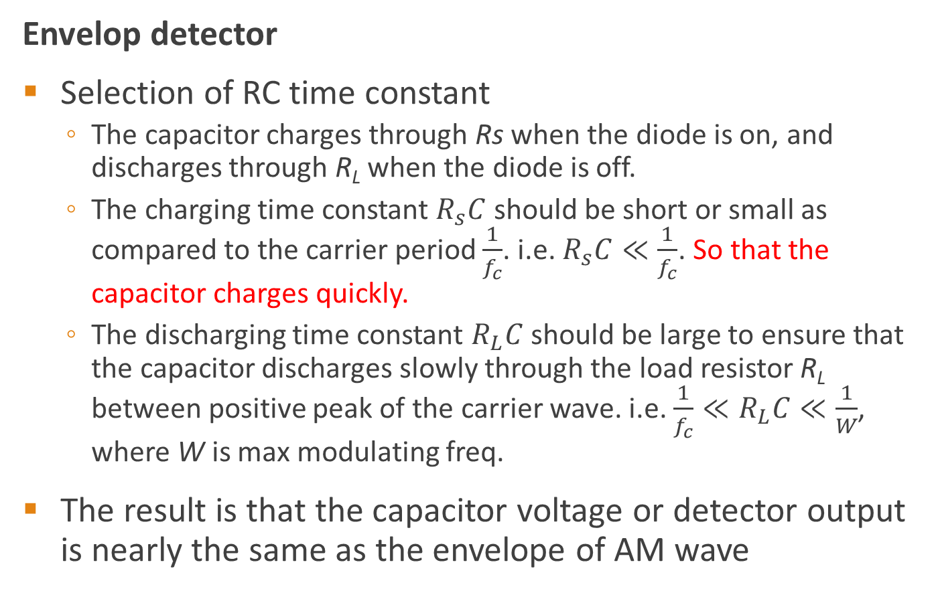
Demodulation of conventional AM signal
Envelop detector
Selection of RC time constant
  The capacitor charges through Rs when the diode is on, and discharges through R_{L} when the diode is off.
  The charging time constant $R_{s}C$ should be short or small as compared to the carrier period $\frac{1}{f_{c}}$. i.e. $R_{s}C≪\frac{1}{f_{c}}$. So that the capacitor charges quickly.
  The discharging time constant $R_{L}C$ should be large to ensure that the capacitor discharges slowly through the load resistor R_{L} between positive peak of the carrier wave. i.e. $\frac{1}{f_{c}}≪R_{L}C≪\frac{1}{W}$, where W is max modulating freq.
The result is that the capacitor voltage or detector output is nearly the same as the envelope of AM wave

Slide 37
Advantages, disadvantages and applications of AM
Advantages | Disadvantages
AM transmission are less complex | Power wasted in the transmitted signal. Most of the transmitted power is in the carrier wave which does not carry any information
Receivers as simple and detection is easy | AM is wasteful of channel bandwidth The transmitted signal requires twice the bandwidth of the message. This is due to the transmission of both sidebands.
AM receivers are cost efficient | Easily affected by channel noise
AM requires larger bandwidth
Applications
i) Radio broadcasting
ii) Picture transmission in TV system, etc

Slide 38
DSB-SC Modulation
DSB-SC overcomes the shortcomings of DSB-FC, where only a fraction of the total transmitted power is affected by the intelligent signal.
The efficiency of conventional AM is around 33.3 % based on the modulation index.
This problem is solved by suppressing the carrier component of the modulated wave, hence DSB-SC.

Slide 39

DSB-SC Modulation
DSB-SC is obtained by product modulator that simply multiples the message signal m(t) by the carrier wave c(t)
$$s(t)=A_{c}m(t)cosω_{c}t$$

Slide 40
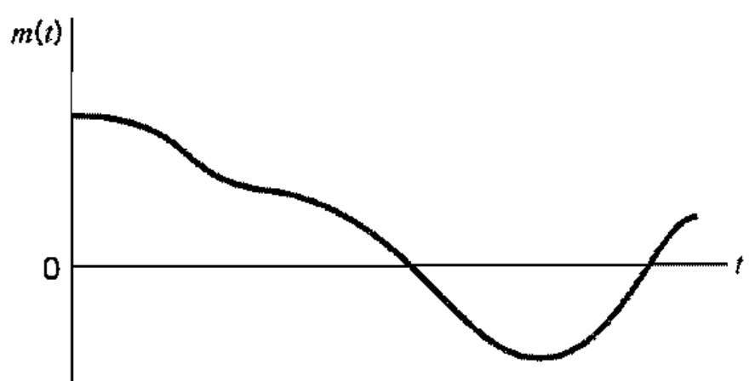
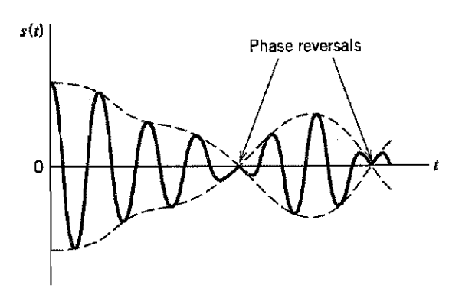

DSB-SC Modulation
$$s(t)=A_{c}m(t)cosω_{c}t$$
The modulated signal s(t) undergoes phase reversal whenever the message signal m(t) crosses zero

Slide 41

Bandwidth requirement of DSB-SC
DSB-SC wave form is
$$s(t)=A_{c}m(t)cos\left(ω_{c}t+φ_{c}\right)$$
To get the bandwidth, we take Fourier transform of s(t)

Slide 42
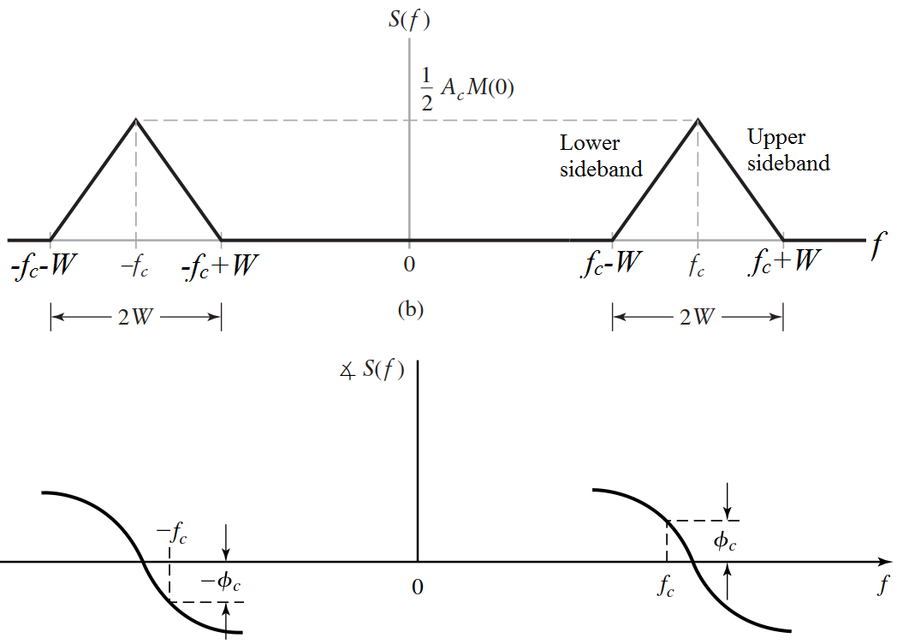
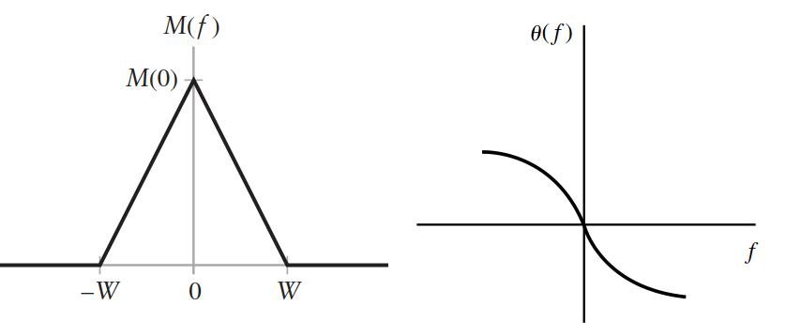
Bandwidth requirement of DSB-SC
Since $S(f)$ contains both the upper and the lower sidebands, it is called a double-sideband (DSB) AM signal
Notes:
$$s(t)=A_{c}m(t)cos\left(ω_{c}t+φ_{c}\right)$$

Slide 43
Bandwidth requirement of DSB-SC
The frequency content of the modulated signal s(t) in the frequency band |𝑓|>𝑓_{𝑐} is called the upper sideband of 𝑆(𝑓), and
the frequency content in the frequency band |𝑓|<𝑓_{𝑐} is called the lower sideband of 𝑆(𝑓)
The upper sideband of 𝑆(𝑓) contains all the
frequencies in 𝑀(𝑓). A similar statement applies to the lower sideband of 𝑆(𝑓).
DSB-SC signal does not contain carrier component.
All power transmitted is within m(t) since the carrier is suppressed, hence the name SC.

Slide 44
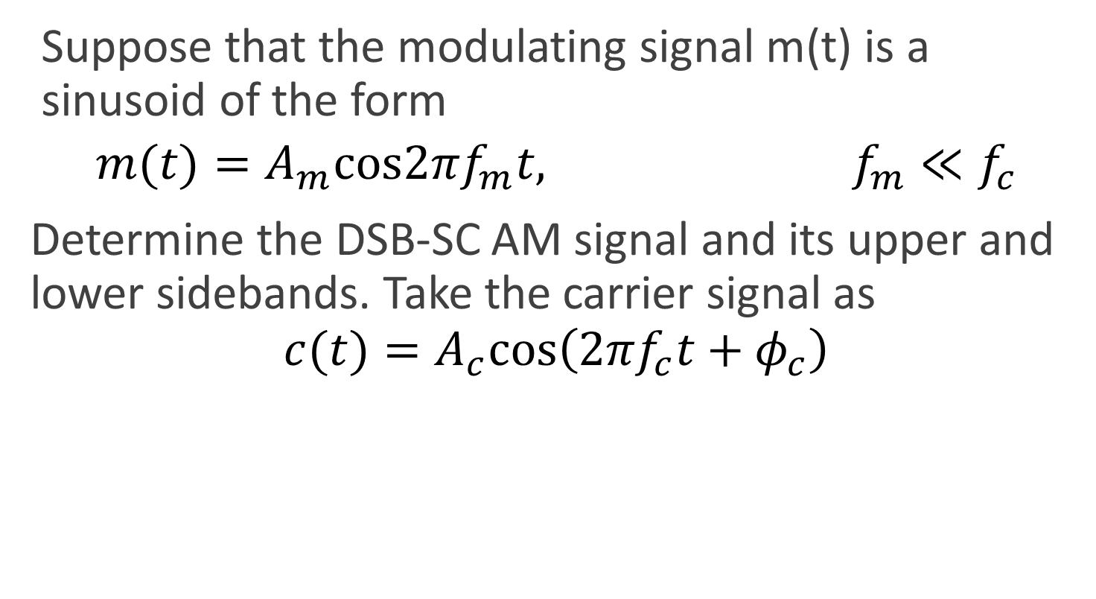
Example 4.1 pg 68
Suppose that the modulating signal m(t) is a sinusoid of the form
$$m(t)=A_{m}cos2πf_{m}t, f_{m}≪f_{c}$$
Determine the DSB-SC AM signal and its upper and lower sidebands. Take the carrier signal as
$$c(t)=A_{c}cos\left(2πf_{c}t+φ_{c}\right)$$

Slide 45
Power content of DSB-SC
The power content of the DSB-SC signal will be found by assuming that the phase of the signal is set to zero (i.e. φ_{c} = 0).
This is because the power in a signal is independent of the phase of the signal.
The time-average autocorrelation function of the signal, s(t) is given by

Slide 46
Power content of DSB-SC
PSD of s(t) is obtained by taking Fourier transform both sides of Eqn. 4.1.3
4

Slide 47
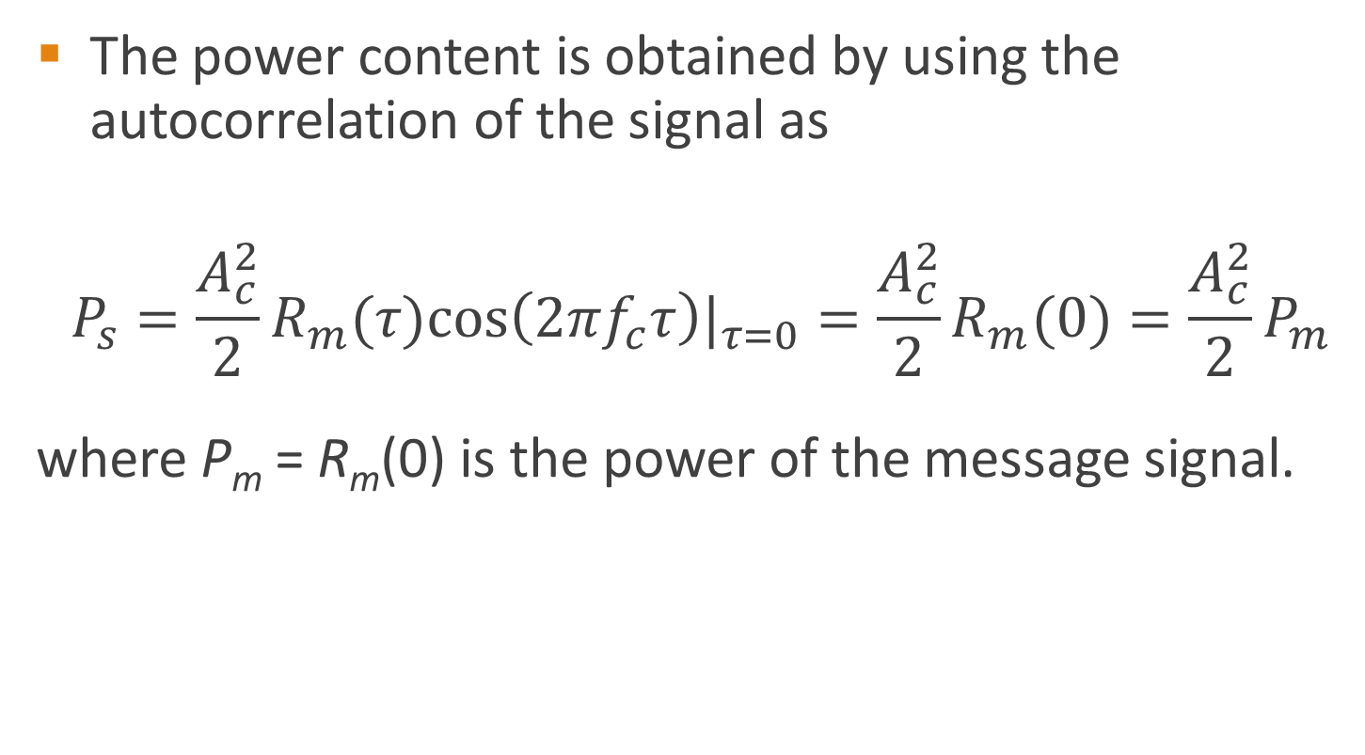
Power content of DSB-SC
The power content is obtained by using the autocorrelation of the signal as
$$\begin{matrix}P_{s}={\frac{A_{c}^{2}}{2}R_{m}(τ)cos\left(2πf_{c}τ\right)|}_{τ=0}=\frac{A_{c}^{2}}{2}R_{m}(0)=\frac{A_{c}^{2}}{2}P_{m} \\ \end{matrix}$$
where P_{m} = R_{m}(0) is the power of the message signal.

Slide 48
Example 4.2 pg 70
As a follow up to Example 4.1, determine the PSD of the modulated signal, the power in the
modulated signal, and the power in each of the sidebands.

Slide 49

Self-check
A signal m(t) bandlimited to 5 kHz is DSB modulated by $cos\left(2πf_{c}t+φ_{c}\right)$ to yield s(t). For what value of carrier frequency fc, will the bandwidth of s(t) be 2% of fc

Slide 50

Self-check
Determine the power-spectral density of the modulated signal, the power in the modulated signal, and the power in each of the sidebands. Given the modulated signal as
$$\left.s(t)=A_{c}A_{m}cos(ω_{m}t)cos(ω_{c}t+φ_{c}\right)$$

Slide 51

Generation (modulation) of DSB-SC
A DSB-SC wave consists of the product of the modulating signal m(t) and the carrier signal,
usually c(t) to yield s(t)

Slide 52


Generation (modulation) of DSB-SC
Nonlinear modulator
The input-output relationship of either of the NL is
$$\left.y(t)=ax(t)+bx^{2}(t\right)$$

Slide 53
Generation (modulation) of DSB-SC
Balanced modulator
  The balanced modulator consist of amplitude modulators interconnected in a way to suppress
  the carrier.
  One input to the amplitude modulator is from an oscillator that generate the carrier
  wave.
  The second input to the top modulator is the message signal m(t) while the bottom one takes − m(t).

Slide 54


Generation (modulation) of DSB-SC
The outputs of the AM modulators are
$$x_{1}(t)=A_{c}\left[\left.1+K_{a}m(t\right)\right]cosω_{c}t$$
and
$$x_{2}(t)=A_{c}\left[\left.1−K_{a}m(t\right)\right]cosω_{c}t$$
The output of the summer is
$${s\left(t\right)=x}_{1}\left(t\right)−x_{2}(t)$$

Slide 55


Generation (modulation) of DSB-SC
The output of the summer is
$${s\left(t\right)=x}_{1}\left(t\right)−x_{2}(t)$$
Finally,
$$s(t)=2A_{c}K_{a}m(t)cosω_{c}t$$

Slide 56


Generation (modulation) of DSB-SC
Finally,
$$s(t)=2A_{c}K_{a}m(t)cosω_{c}t$$
The balanced modulator output is equal to the product of the modulating signal m(t) and carrier c(t) except the scaling factor 2K_{a}.
$$S(f)=A_{c}K_{a}\left[\left.M(f−f_{c})+M(f+f_{c}\right)\right]$$
Notes:
K_{a} is the amplitude sensitivity of the modulator measured in
per volts.

Slide 57

Generation (modulation) of DSB-SC
Switching (Ring) modulator
Ring modulators frequency mix or heterodyne two waveforms, and output the sum and difference of the frequencies present in each waveform.
Multiplication in the time domain is the dual of convolution in the frequency domain, so the output waveform contains the sum and difference of the input spectral components.
Notes:
The carrier alternates between positive and negative current, at any given time. This makes one pair of diodes conduct, and reverse-biases the other pair.
The conducting pair carry the signal from the left transformer secondary to the primary of the transformer at the right.
During the positive half-cycles of the carrier, diodes D1 and D3 conduct (i.e. forward biased), and D2 and D4 are set open. Hence, terminal a is connected to c, and terminal b is connected to d.
Basically, the modulator multiplies the message signal m(t) by +1 and therefore, Vo(t) = m(t).
During the negative half-cycles of the carrier, diodes D1 and D3 are set open, and D2 and D4 are conducting, thus connecting terminal a to d and terminal b to c.
This way, the output is proportional to m(t) during the positive half-cycle and to –m(t) (i.e. Vo(t) = –m(t)) during the negative half-cycle.

Slide 58

Generation (modulation) of DSB-SC
Switching (Ring) modulator
  c(t) is a square wave with Fourier series as
  $$c(t)=\frac{4}{π}\sum_{n=1}^{∞}{\frac{{\left(−1\right)}^{n−1}}{2n−1}}cos\left[2πf_{c}(2n−1)t\right]$$
  The output s(t) is given by
  $$s(t)=\frac{4}{π}m(t)cos2πf_{c}t−\frac{4}{3π}m(t)cos6πf_{c}t+......$$
  The DSB-SC wave is extracted from s(t) by passing it through an ideal BPF having carrier frequency f_{c} and bandwidth equal to 2W Hz.
  The output of the BPF is
  $s(t)=\frac{4}{π}m(t)cos2πf_{c}t$
Notes:
The carrier signal is ideally a square wave, whose Fourier expansion contains the fundamental and a series of reducing-amplitude odd harmonics

Slide 59

Demodulation of DSB-SC
In the absence of noise and ideal channel, the received signal is equal to the modulated signal
$$\left.r(t)=s(t)=A_{c}m(t)cos(2πf_{c}t+φ_{c}\right)$$
Demodulation is done by multiplying r(t) by a sinusoid $cos\left(2πf_{c}t+φ\right)$
Pass the resulting signal through ideal LPF with bandwidth W
Thus
$$\left.r\left(t\right)cos\left(2πf_{c}t+φ\right)=A_{c}m(t)cos(2πf_{c}t+φ_{c})·cos(2πf_{c}t+φ\right) =\frac{1}{2}A_{c}m(t)cos(φ_{c}−φ)+\frac{1}{2}A_{c}m(t)cos(4πf_{c}t+φ+φ_{c})$$

Slide 60
DSB-SC Advantages & disadvantages
Advantages | Disadvantages
Low Power consumption or power saying | Design of receiver is complex
The modulation system is simple | Bandwidth required is same as that of AM
Efficiency is more than AM | The receiver must generate a replica of the carrier in order to demodulate a DSB-SC signal
Carrier wave is suppressed | Any phase and/or frequency error will result in a distorted estimate of the message signal
Linear modulation type is required | It is difficult to generate a perfect replica of the transmitted carrier
It can be used for point to point communication | A simple modification to the technique results in a less efficient transmission but simplifies the detection process greatly

Slide 61
Example 4.3 pg 78
Find the value of A_{o} as well as the frequencies of the modulating signal and the carrier.
What is the power in the modulated signal? Indicate assumptions, if any.

Slide 62
Single-Sideband (SSB-SC) AM
Either of the sidebands (i.e. USB or LSB) contains the complete intelligent signal.
It is possible to transmit one of the sidebands
SSB is widely used in military communication application
Bandwidth for SSB is half of the bandwidth of AM or DSB-SC.
SSB conserve bandwidth by transmitting only one sideband.

Slide 63

Single-Sideband (SSB-SC) AM
Consider DSB-SC modulated wave
Eqn. 4.3.1
Eqn. 4.3.1 has two-side freqs
SSB can be generated from the LSSB or USSB
Using USSB →$f_{c}+f_{m}$, suppressing the second term in Eqn. 4.3.1, hence
$$S_{USSB}(t)=\frac{1}{2}A_{c}A_{m}cos\left[2π(f_{c}+f_{m})t\right]$$

Slide 64

Single-Sideband (SSB) AM
Using LSSB →$f_{c}−f_{m}$, suppressing the first term in Eqn. 4.3.1, yields
$$S_{LSSB}(t)=\frac{1}{2}A_{c}A_{m}cos\left[2π(f_{c}−f_{m})t\right]$$
Finally, SSB equation is
$$S_{SSB}(t)=\frac{1}{2}A_{c}A_{m}cos(2πf_{c}t)cos(2πf_{m}t)∓\frac{1}{2}A_{c}A_{m}sin(2πf_{c}t)sin(2πf_{m}t)$$
where the plus sign applies to lower SSB and the minus sign to upper SSB

Slide 65

Generation of SSB-SC
The Hilbert transform filter is used to filter out the unwanted sideband before transmission

Slide 66
Generation SSB-SC – filtering method
Antenna
DSB
signal
SSB
signal
Carrier
oscillator
Balanced
modulator
Sideband
filter
Linear
amplifier
Filter
response
curve
Microphone
Audio
amplifier
Lower
sidebands
Upper
sidebands

Slide 67

Single-Sideband (SSB) AM
The selection of the sideband is done by using Hilbert transform filter

Slide 68
Example
a) For an AM DSB-FC wave with a peak unmodulated carrier voltage V_{c} = 10 Vp, frequency of 100kHz, a load resistor of R_{L} = 10 Ω, frequency of modulating signal of 10 kHz and m = 1, determine the following:
  Powers of the carrier and the upper and lower sidebands.
  Total power of the modulated wave.
  Bandwidth of the transmitted wave.
  Draw the power and frequency spectrum.
b) For the same given values, determine questions (ii)-(iv) for a AM DSB-SC, AM SSB-FC and AM SSB-SC systems. Determine also the percentage of power saved in each of the system design.

Slide 69
Solution
Solution for DSB-FC
i)
ii)

Slide 70
Solution
Solution: For DSB-SC
ii)
iii)Bandwidth=2xf_{mmax}=2(10kz)=20kHz
iv)
90kHz
110kHz

Slide 71
Solution
Solution: For SSB-FC
ii)
iii)Bandwidth=f_{mmax}=10kHz
iv)
f_{c}-f_{m}
100kHz
110kHz

Slide 72
Solution
Solution: For SSB-SC
ii)
iii)Bandwidth = f_{mmax}=10kHz
iv)
f_{c}-f_{m}
110kHz
f_{c}

Slide 73
Applications of SSB
SSB is used in the systems which require minimum bandwidth such as telephone
multiplex system
Point to point communications at frequency below 30 MHz -mobile communications,
military, navigation radio etc. where power saving is needed

Slide 74
Advantages of SSB
Power conservation
  Less power is required to transmit either of the sideband
Bandwidth conservation
  It requires half as much bandwidth as DSB AM →50 % reduction in bandwidth
Selective fading e.g. sideband, carrier and sideband phase shift
Noise reduction
  Thermal noise is reduce by half that of a DSB system since the bandwidth required is also half

Slide 75
Disadvantages of SSB
Complex receivers
Tuning difficulties

Slide 76
Vestigial sideband (VSB)
Also called asymmetric sideband system.
Allowing a part of unwanted sideband, called a vestige to appear at the output of the modulator
Compromise between DSB & SSB.
Easy to generate.
Bandwidth is only ~ 25% greater than SSB signals.
Derived by filtering DSB, one pass band is passed almost completely while just a trace or vestige of the other sideband is included.

Slide 77



Vestigial sideband (VSB)
AM wave is applied to a vestigial sideband filter, producing a modulation scheme – VSB + C
The output of the vestigial filter is
$$\left.s(t)=\left[A_{c}m(t)cos2πf_{c}t\right]⋆h(t\right)$$
$$\left.s(t)=\left[A_{c}m(t)cos2πf_{c}t\right]⋆h(t\right)$$

Slide 78

Vestigial sideband (VSB)
VSB Frequency Spectrum
VSB
Carrier
LSB
USB
f_{c}
fc
Transmission bandwidth
$$B_{T}=f_{v}+W$$
where f_{v} is the vestige bandwidth and W is the message bandwidth
f_{v} is usually 25 % of W → VSB lies between SSB bandwidth W and DSB-SC, 2W.

Slide 79

Demodulation of VSB
Notes:
Mainly used for television video transmission.

Slide 80
VSB & SSB-SC
Vestigial sideband (VSB) modulation distinguishes itself from SSB modulation in two practical
respects:
Instead of completely removing a sideband, a trace or vestige of that sideband is transmitted;
Instead of transmitting the other sideband in full, almost the whole of this second band is
also transmitted.

Slide 81

Conventional AM

